Slide 1


SAP S/4HANA Training
MASTER DATA GOVERNANCE (SAP MDG)
Neeraj Gupta
Session 22
SAP MDG – Integration Scenarios, Generic Extractor for Initial Load

Slide 2
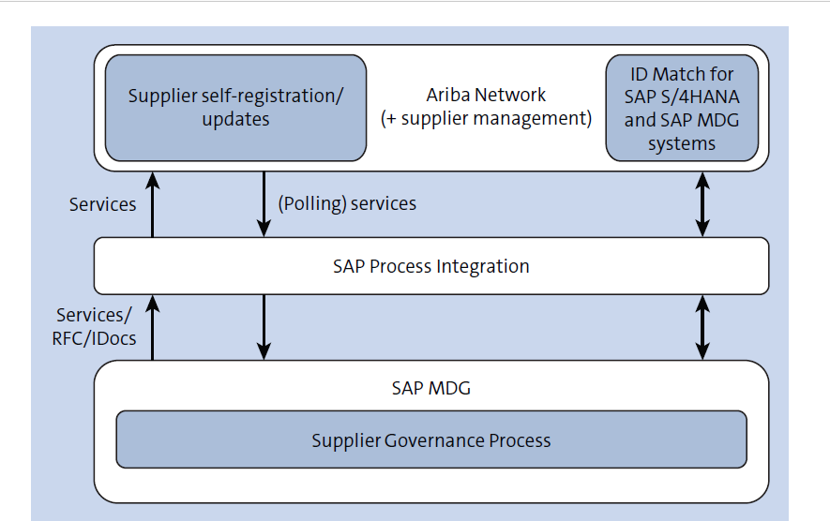
SAP Ariba with SAP MDG
22
SAP MDG – Integration Scenarios

Slide 3
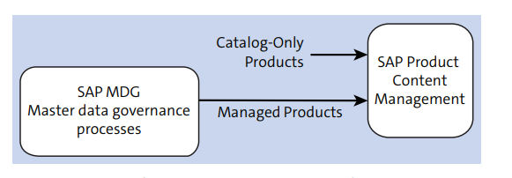
SAP MDG with SAP Product Content Management
22
SAP MDG – Integration Scenarios

Slide 4
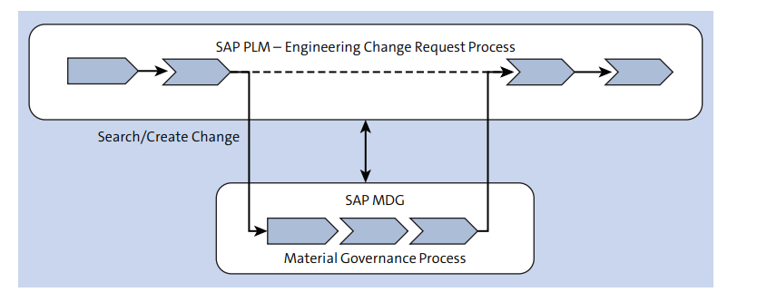
SAP PLM with SAP MDG Integration
22
SAP MDG – Integration Scenarios

Slide 5
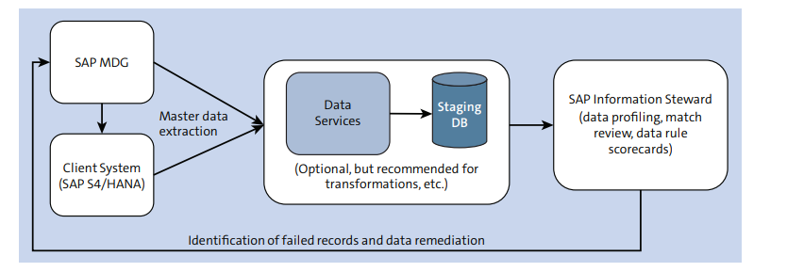
SAP MDG data Remediation with SAP Information Steward
22
SAP MDG – Integration Scenarios

Slide 6
MDMGX Transaction
22
SAP MDG – Generic Extractor (Initial Load)
Initial load of master data / customizing data from SAP ECC or SAP S/4 HANA systems into the MDG hub.

Slide 7
Object Types
22
SAP MDG – Generic Extractor (Initial Load)
Single MDM Object type for one data model

Slide 8
Definition of repositories and FTP servers
22
SAP MDG – Generic Extractor (Initial Load)
Single repository for each entity type with SU Type 1 of the target MDG data model

Slide 9
Define Repositories and FTP servers
22
SAP MDG – Generic Extractor (Initial Load)
Single repository for each entity type with SU Type 1 of the target MDG data model

Slide 10
Pre-configuration of ports and check tables (Text Files)
22
SAP MDG – Generic Extractor (Initial Load)
MDG-F 7.0: 1882127
• MDG-F 8.0 to MDG9.1: 2151430
• MDG 9.2 or MDG-F 1809: 2707723
Maintain Ports and Check-Tables

Slide 11
Methods to limit the extraction (Define selection criteria)
22
SAP MDG – Generic Extractor (Initial Load)
1. Use the chart of accounts (KTOPL) for the extraction of A-Segments and relevant texts
2. Use the company code (BUKRS) for the extraction of B-Segments.
3. General WHERE CLAUSE delivered by SAP for ports ACCOUNTS_COA respectively ACCOUNTS_DESCR is SKA1~KTOPL = ‘INT’ respectively SKAT~KTOPL = ‘INT’. Adding further criteria for field SAKNR limits the selection for specific accounts.
4. The general WHERE CLAUSE delivered by SAP for port ACCOUNTS_CC is SKB1~BUKRS = ‘0001’. Adding further criteria for field SAKNR limits the selection for specific accounts.
5. The following examples show possible adjustments.
a. SKA1~KTOPL = ‘INT’ AND SKA1~SAKNR > ‘0000120000’ limits the selection to all accounts with the ID greater than 120000 for chart of accounts INT.
b. SKB1~BUKRS = ‘0001’ AND SKA1~SAKNR = ‘0000120000’ limits the selection to the single account 120000 in company code 0001.

Slide 12
Define Function Module Parameters for Exceptional Cases
22
SAP MDG – Generic Extractor (Initial Load)

Slide 13
Define Function Module Parameters for Exceptional Cases
22
SAP MDG – Generic Extractor (Initial Load)
Use case: Cost Elements require function modules for the master data extraction
ERP backend MDG-F data model
CSKA Only one entity type CELEM
CSKB
CSKU
Solution: Extraction consists of two ports to separate
1. Port COST_ELEMENTS extracts only the master data from tables CSKB and CSKA
Function module MDM_ERP_CELEM_EXTR
2.Port COST_ELEMENTS_DESCR extracts the texts from tables CSKB and CSKU
Function module MDM_ERP_CELEM_DESCR_EXTR
3. Selection criteria: a. Time Slice using valid from / valid to Dates
b. Controlling area (KOKRS)

Slide 14
Start extraction Triggers the actual data extraction from the current MDG client system into an XML file
22
SAP MDG – Generic Extractor (Initial Load)

Slide 15
Start extraction Triggers the actual data extraction from the current MDG client system into an XML file
22
SAP MDG – Generic Extractor (Initial Load)

Slide 16
Next Steps .. > DIF (Impot MDG-F master data)
22
SAP MDG – Generic Extractor (Initial Load)
Upload extracted Files to the Application Server – CG3Z
Starting the Data Import Framework Application
Example:
Following steps are required to prepare the upload of profit centers
1. Select Object Type Profit Center – PCTR.
2. Maintain a meaningful Description for the import of master data.
3. On the list for Data Sources click the Add button.
4. Select the Object Type Profit Center in the pop-up and confirm with OK.
5. Use the F4 help for Source Directory to select the one that contains the data to be imported.
6. It is possible to optionally check the content of the directory by clicking on button Show Directory Content.
7. Define a Change Request Type and an Edition for the import.

Slide 17

End of Session22

Slide 18

Questions

Slide 19

Neeraj gupta

Slide 20


We’re committed to empower you to be
Most Desirable Resource
through powerful training solutions.
We build the workforce of the future.
250+
Corporate Clients
30,000+
Learners Trained
25000+
Learners Placed
FREE WEBINARS
Sign up for free webinars with industry experts every fortnight!
Enroll Now!
Contact us today!
https://anubhavtrainings.com/

Slide 21




More from AnubhavTrainings.com

